Slide 1
Security Operations Threat Monitoring and Detection
Security Operations, often referred to as SecOps, involve the continuous monitoring and management of an organization's security posture. This function combines processes, tools, and skilled personnel to detect, investigate, and respond to security threats and incidents. The goal of SecOps is to protect an organization's digital assets, ensure compliance with regulatory requirements, and minimize the impact of security incidents.
Lecture at Technical University of Berlin
Jorge Cardoso
Chief Engineer for Hyperscale AIOps
Munich Research Center
2023.04.12

Slide 2
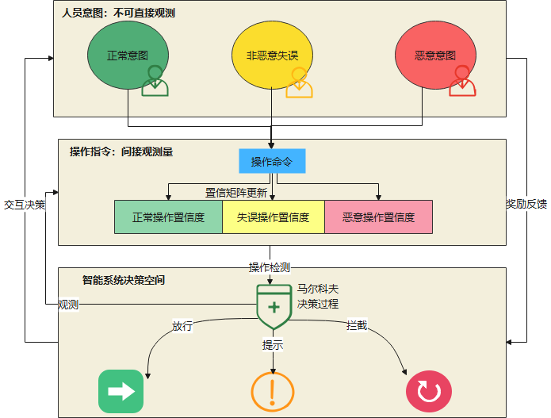
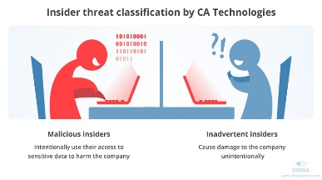

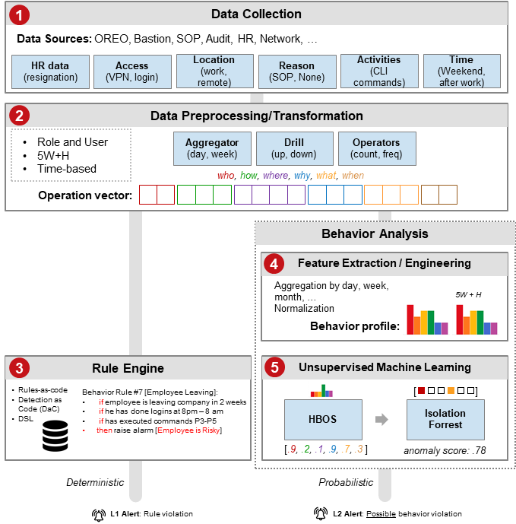




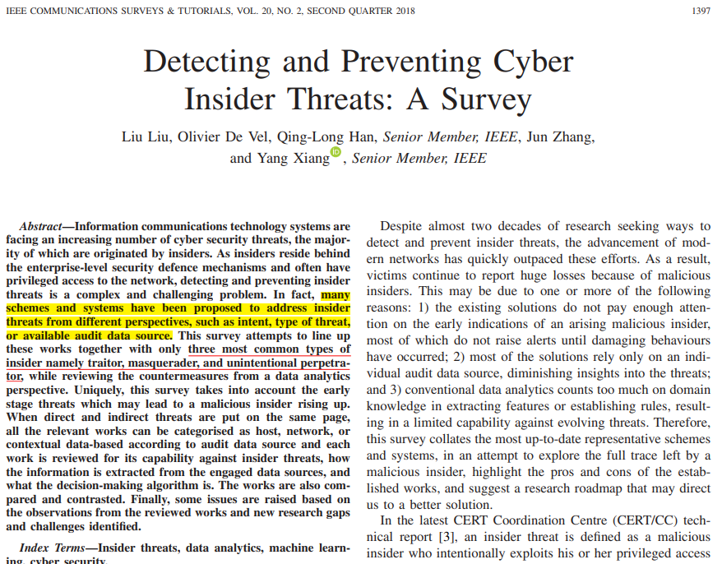
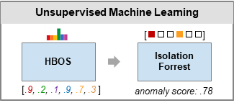
Security Operations Threat Monitoring and Detection
Insider Threats can cause IT disruptions affecting productivity, profitability, and reputation
MAIN ACHIEVEMENT
System Design
Literature Review of key approaches for Insider Thread detection
Competitor Analysis
System and Algorithm Design
Reduce the number of incidents
Malicious operation evaluation
security interceptor
Data extraction/
integration
Blocklist and trustlist
Change
Resource isolation
......
Operation log
Change Content
Personnel and rights
......
CLOUD PROVEIDERS
HOW IT WORKS
Safety equipment
Input data: SOP, Audit, HR, Network, IAM, logging
O&M channel
Network devices
Server
Problem
Hyperscalers undergoes 1k+ changes per day
Rapid detection of abnormal behaviors/operations is required to ensure live network security
terminal
Data Center
DB
Pre-processing: Apply transformations to incoming data
Fig. Automatically identify malicious operations so they can be intercepted
Rule engine: Apply known expert rules
Combine rule-based and Machine Learning algorithms
Feature Extraction
Machine Learning: Automatically detect abnormal behavior
Multi-dimensional behavior modeling
5WH model: 5W → What, Where, When, Why, Who; H → How
Construct vectors for user activities and profile information at different granularity level
ASSUMPTIONS & LIMITATIONS
Proposal can generate too many false positives
Filtering/noise reduction techniques need to be explored
TRL 2: Technology formulation. Principles have been studied and practical applications can be developed based on initial findings
Liu, Liu, et al. "Detecting and preventing cyber insider threats: A survey." IEEE Communications Surveys & Tutorials 20.2 (2018): 1397-1417.

Slide 3
Background Scope
Requirements
State of
the Art
System Design
ML Design
What Is an Insider Threat?
Threats come from a trusted individual or privileged user who is authorized to access your organization’s IT assets. It includes former employees; or outsiders, such as contractors and can damage IT in many ways:
IT disruptions affecting productivity and profitability
Reputational damage
Insider Types
Malicious insiders: purposefully damage IT systems. They may be ex-employees or unhappy employees seeking revenge (unhappy employees, personal motive, espionage).
Negligent insiders: are those inside the organization who unintentionally misuse or abuse computer systems
Insider methods
Execute authorized or unauthorized commands to damage IT systems
Exploitation of physical security vulnerabilities: where the attacker is physically inside the building or the data center
Script or program: development of a program or script, like a logic bomb, and then creating a backdoor account to be used later to initiate the script or include a time for activation in the script
Keywords
User and Entity Behavioral Analytics (UEBA) solutions
User Activity Monitoring (UAM) solutions
Digital forensics, incident response, internal threat, insider threat, investigations
Challenges
Extremely Unbalanced Data. Activities from insiders are extremely rare in real-world scenarios
Temporal Information in Attacks. Many approaches focus on activity type, e.g., copying files to USB or browsing a Web page, incorporating temporal information is important and challenging. Copying files in working hours looks normal, but copying files at mid-night is suspicious
Heterogeneous Data Fusion. temporal information, layoff, user profile (i.e., psychometric score), etc.
Subtle Attacks. To evade detection, insider threats are subtle and hard to notice, which means that insiders and benign users are close in the feature space
Adaptive Threats. Insiders always improve attacking strategies to evade detection. However, the learning-based models are unable to detect new types of attacks after training.
Fine-grained Detection. Existing approaches usually detect malicious sessions that contain malicious activities. However, users usually conduct a large number of activities in a session. Hence, how to identify the fine-grained malicious subsequence or the exact malicious activity is important
Early Detection. Approaches focus on insider threat detection, which means malicious activities already occur and the significant loss is already caused to organizations, Prediction is also important
Lack of Testbed. No real-world dataset that is publicly-available.

Slide 4
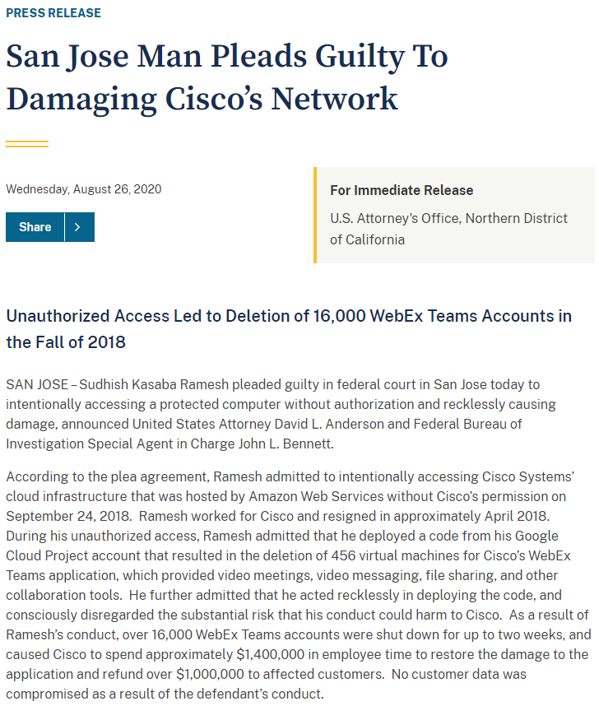
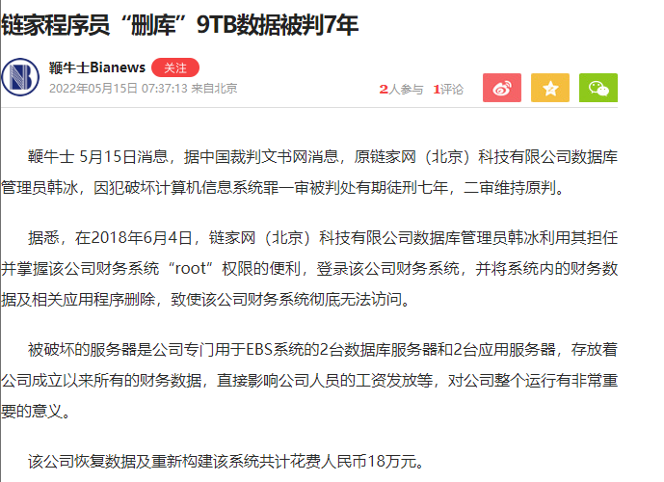

Requirements Examples Provided by HQ
Requirements
State of
the Art
System Design
ML Design
1
2
3
On February 23, Weimob, a leading domestic SaaS service provider, suffered a vicious deletion incident, and it was not until March 1 that the data was fully retrieved, and various businesses gradually returned to normal.
This incident exposed the problem that Chinese enterprises have long emphasized business support and implementation in IT construction, while paying attention to and investing in support systems such as security operation and maintenance, disaster preparedness and disaster recovery, which has caused a great shock to the industry.
… the former database administrator of Lianjia Network Technology Co., Ltd., was sentenced […] for the crime of damaging computer information systems […].
…Han Bing, the database administrator of Lianjia.com (Beijing) Technology Co., Ltd., used his "root" permission of the company's financial system to log in to the company's financial system and delete the financial data and related applications in the system, making the company's financial system completely inaccessible […]
https://cloud.tencent.com/developer/article/1862390?from=15425
https://www.justice.gov/usao-ndca/pr/san-jose-man-pleads-guilty-damaging-cisco-s-network
https://tech.ifeng.com/c/8G1klaVX7pY
Source https://clouddevops.huawei.com/domains/29680/wiki/1/WIKI2022092000894

Slide 5
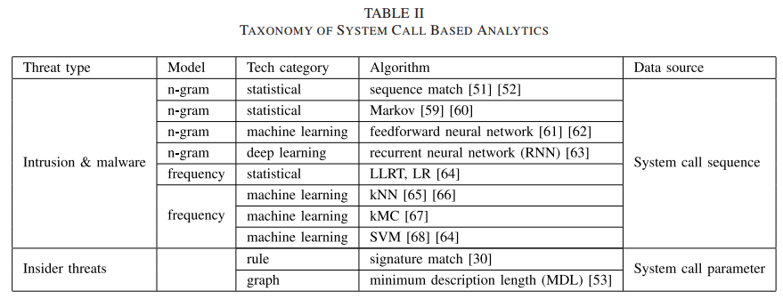
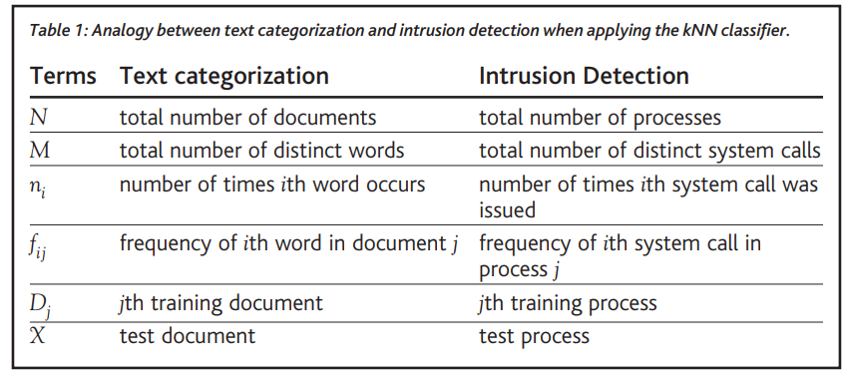
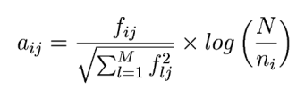
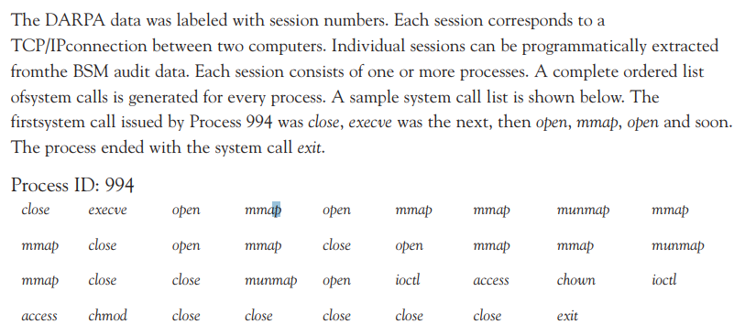
Literature Review Frequency-based methods
Requirements
State of
the Art
System Design
ML Design
Main idea
Use the frequencies of system calls to characterize user behavior
Technique
Sequences of system calls are transformed into a fixed-length frequency vector according to the occurrence number of system calls
Apply, e.g., k-nearest neighbour (kNN), k-means clustering or support vector machine (SVM) to identify anomalous frequency vectors
Use tf-idf weighting to encode system calls
1) Use only normal vector: if unknown frequency vector has a high similarity using cosine distance to a normal vector, mark the sequence as normal
2) Use normal and abnormal vectors: use the same distance function as with 1)
TF-IDF Technique: Text Processing Metaphor [1]
Each system call is treated as a “word” of a document
Set of system calls generated by a process is treated as a “document”
Use text processing methods for intrusion detection problem, e.g., k-nearest neighbor classification method
Sample system call list: The first system call issued by Process 994 was close, execve was the next, then open, mmap, open and soon. The process ended with the system call exit.
[1] Use of K-Nearest Neighbor classifier for intrusion detection

Slide 6

Literature Review Frequency-based methods: Practical Example
Requirements
State of
the Art
System Design
ML Design
HR
Change Orders
SOP
OREO
Empl_Id | Qualification
J00760260 | Class-2
X00123456 | Class-1
Order_Id | Class | Empl_Id
OID111 | Class-B | J00760260
OID112 | Class-A | X00123456
Order_Id | Command
OID111 | ps -ef
OID111 | rm /tmp/*.yaml
Order_Id | Command
OID111 | ps –ef
OID111 | kill -9 123
Data,
Events
DataLake, databases, tables
1
Data
Business Rule
Technical Rule (e.g., KQL)
Use Case 1. Authorized Insider
Internal operator executes commands with a change order
MITRE ATT&CK Framework:
https://attack.mitre.org/techniques/T1059/004/
https://attack.mitre.org/datasources/DS0017/
Description
Huawei employees with Class-2 operation qualification (the highest qualification) uses Class-B change orders to escalate rights to the bastion host, and then exploit the bastion host vulnerabilities to execute Commands (e.g., rm -rf XX) that are not described in the change guide.
HR
| where Qualification == "Class-2"
| project Empl_Id
| join (Change_Orders
| where Class == "Class-B"
| project Order_Id)
on Empl_id
| join (SOP
| project Cmd)
on Order_Id
| join (OREO
| project Order_Id, Cmd)
kind = rightanti on Cmd, Order_Id
| summarize NumCmd=count() by Order_Id
Rules
2
Results
3
Order_Id | NumCmd
OID111 | 1
Results
[1] MITRE ATT&CK Framework: https://attack.mitre.org
https://clouddevops.huawei.com/domains/29680/wiki/1/WIKI2022112101100

Slide 7
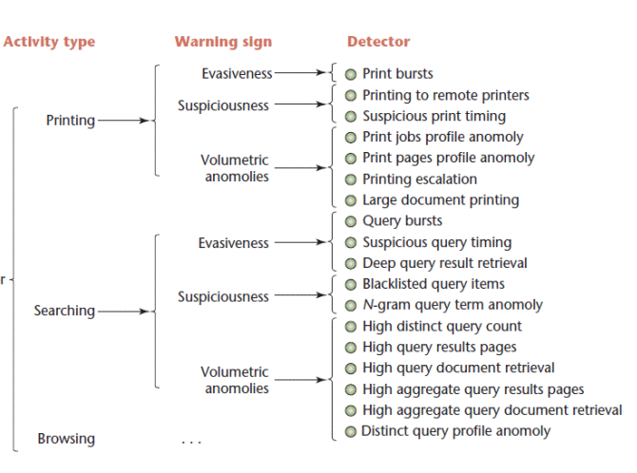
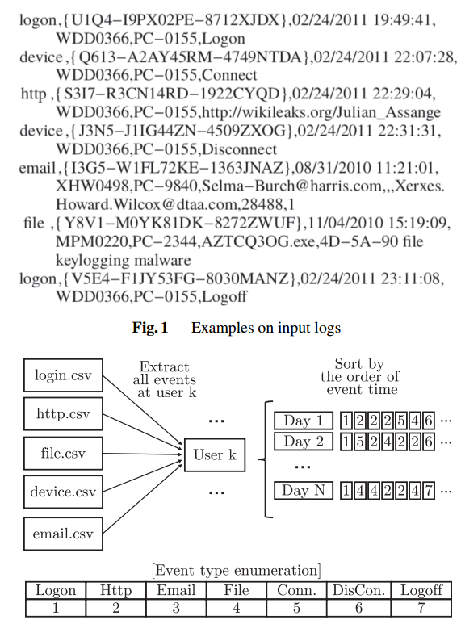
Literature Review Sequence-based methods
Requirements
State of
the Art
System Design
ML Design
Main idea
Host-based analytics / behavioral analysis: model the sequences of user actions and employ them to detect unusual sequences
Analyze system calls (OS), shell command lines (application-level), keystroke/mouse dynamics, *nix syslog, Windows logs, etc.
Data captures how a host behaves and the human interactive behavior with the host
Techniques
Hidden Markov Model (HMM). Rashid et. al. [1]
7 event types; Training: 5 weeks
Logs: login/logoff, web access, USB connection, and email
RNN autoencoder model. Ha et. al. (same method as Rashid et. al.) [1]
Split sequences into small fixed-size sequences
Model clearly outperforms HMM-based models
Stacked LSTM models. Tuor et. al. [1]
408 event types (usage time, email attachments, file operations (e.g., reading, writing, copying, and deletion)
LSTM models and CNN models. Yuan et. al. [1]
16 events types
LSTM with CNN model: AUC = 0.9449 (best)
Seq2seq learning model. Jang, et al. [1]
7 event types; Training: 60 days
Use attention mechanism
Introduce standard deviation factors to estimate each event’s global characteristics
Bayesian Networks. Caputo [3]
Monitors user activities and indicating malicious activities
Elicit detector [3]
Examine how users manipulate Web information
Use electronic records: location, job title, projects
Collected 284 days of data, from 3,900 users, and produced 91 million events
Research team consulted with three subject-matter experts to develop 76 detectors
Implemented detectors using rules and statistical methods. E.g., a rule issues an alert if an individual used a printer other than the one closest to his or her office
Action
Encoding
2
3
Sequence
Encoding
1
Event types
[1]
[1] Against Insider Threats with Hybrid Anomaly Detection with Local-Feature Autoencoder and Global Statistics (LAGS)
[2] Detecting and Preventing Cyber Insider Threats: A Survey
[3] Detecting insider theft of trade secrets, D. Caputo, et. al.

Slide 8
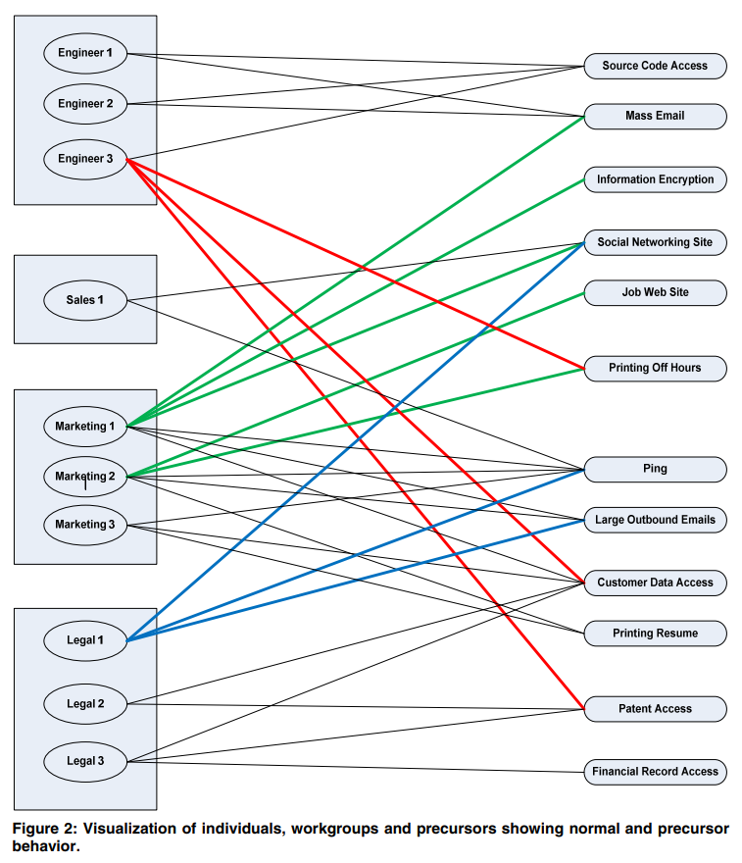
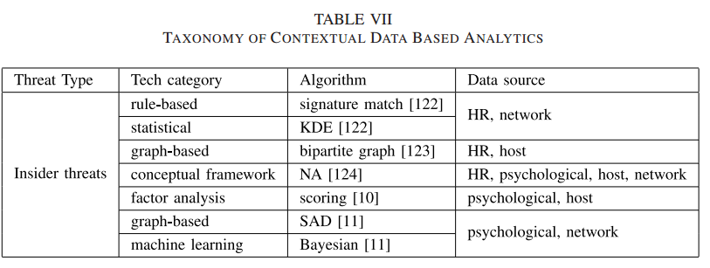
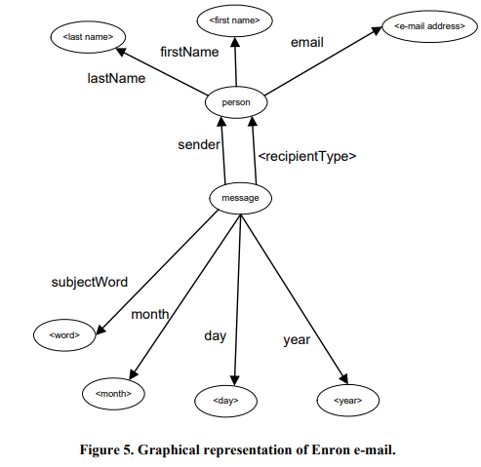
Literature Review Graph-based methods
Requirements
State of
the Art
System Design
ML Design
HR Data
Contextual information regarding a human user such as HR and psychological data
Available from an employee directory or a specific ERP
e.g., type of employment, remaining years of contract, remaining days of leave, job title, salary range, participated projects, business travel records, performance review, etc.
Bipartite graph analysis [1] / Peer Analysis
Establish a pattern of acceptable actions based on workgroup role classifications
Provides a means to identify and determine normal or expected behavior for workgroups
Identifying Threats Using Graph-based Anomaly Detection [2]
1) Find normative patterns in the data using graph-based data mining and
2) Searching for small, unexpected deviations to normative patterns
3) Illicit behavior tries to mimic legitimate, normative behavior
[1] Detecting and Preventing Cyber Insider Threats: A Survey
[2] Identifying threats using graph-based anomaly detection, W. Eberle

Slide 9
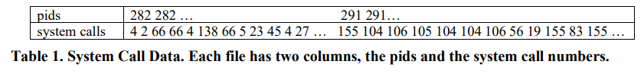
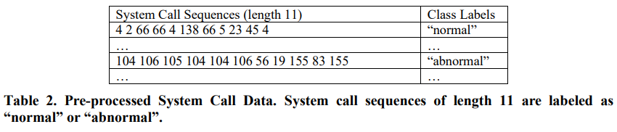
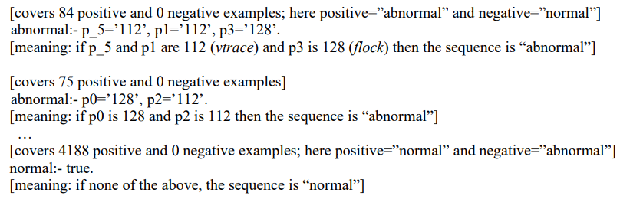
Literature Review Rule-based methods
Requirements
State of
the Art
System Design
ML Design
Main idea
Automatically extract rules from instances
Generalize system calls sequence using a set of rules
Techniques
Use a sliding window (length 11) to create sequences of consecutive system calls
Create two sets of system call data: normal and abnormal
Scan intrusion traces and look it up in the “normal” list
If a match can be found then the sequence is labeled as “normal”. Otherwise it is labeled as “abnormal”
Applied RIPPER (Cohen 1995), a rule learning program, to generate concise rule sets from training data
RIPPER rules can be used to predict whether a sequence is “abnormal“ or “normal “
Use a sliding window of length to scan the predictions made by RIPPER
If the percentage of “abnormal” predictions is above a threshold value, then the trace is an intrusion
1
Example of mapping between pid and sequences of system calls
Example labelled sequences of system calls
2
Example of a rule extracted
3
[1] Learning Patterns from Unix Process Execution Traces for Intrusion Detection, Wenke Lee, et. al.

Slide 10


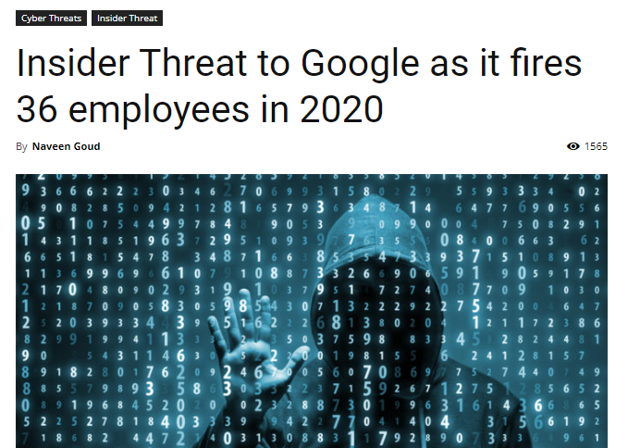

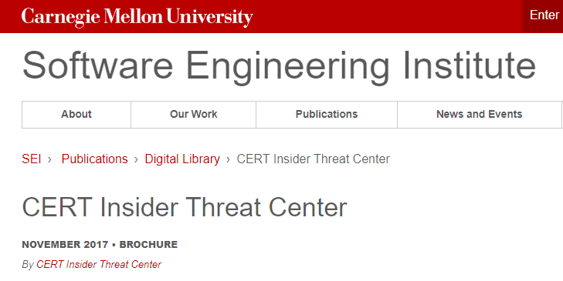
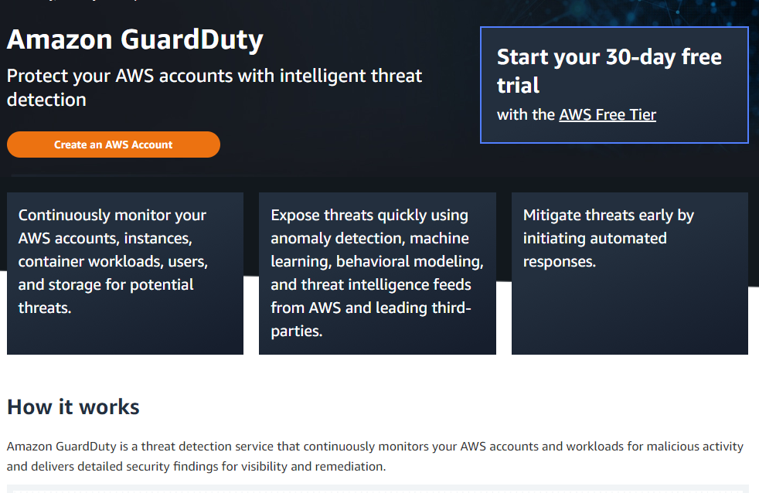
Technology Review Web Articles
Requirements
State of
the Art
System Design
ML Design
1
2
3
Insider threats Mitigation Guidelines
CERT Insider Threat Center and the U.S. National Insider Threat Task Force have issued common guidelines to help prevent and mitigate insider threats in organizational environments [4], [6]. The guidelines in [4] describes 20 practices that organizations should implement across the enterprise to prevent and detect insider threats, as well as case studies of organizations that failed to do so.
[4] M. L. Collins et al., “Common sense guide to mitigating insider threats, fifth edition,” CERT Insider Threat Center, Carnegie Mellon Univ., Pittsburgh, PA, USA, Rep. CMU/SEI-2015-TR-010, 2016.
[6] “Combating the insider threat,” Nat. Cybersecurity Commun. Integr. Center, U.S. Dept. Homeland Security, Washington, DC, USA, Rep., 2014. Accessed: Jun. 15, 2019. [Online]. Available: https://www.uscert.gov/sites/default/files/publications/Combating%20the%20Insider%20Threat_0.pdf
How do you detect insider threats? “here are some of the things Google detection teams typically look for” [1]:
Users from one department or job role accessing or attempting to access data from another in a suspicious way
Large file transfers by employees around the time they're leaving a company
Accesses to services like Dropbox that the company doesn't usually use
Employees with privileged access using that access much more often than their peers
Unusual login activity that might indicate someone using someone else's password or computer
Data leaving the company that shouldn't be, detected by packet inspection (DLP)
Employees reporting that their coworker is acting suspiciously
How do big tech companies minimize the risk of cyber insider threats?
Elevated privileges need to be specifically requested for each use. Ideally each request should have to be approved by another person.
Elevated actions are monitored for suspicious behavior, like someone requesting access to hundreds of accounts when usually they access one.
Making it very visible when a person uses elevated permissions, like sending an email to the team.
Reducing the number of people who need elevated permissions and reducing the permissions they need. For example, if someone needs to view the customer's address, give them access only to the address and not the rest of the customer's information.
Locking down document permissions
[1] https://www.cybersecurity-insiders.com/insider-threat-to-google-as-it-fires-36-employees-in-2020/
[2] David Seidman, Sr Director of Detection @ Salesforce, Head of Detection and Response @ Robinhood, Security Engineering Manager @ Google

Slide 11
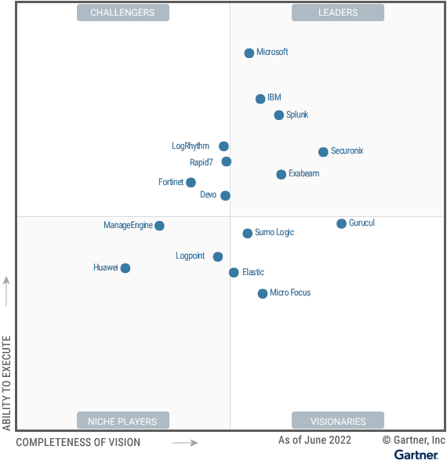
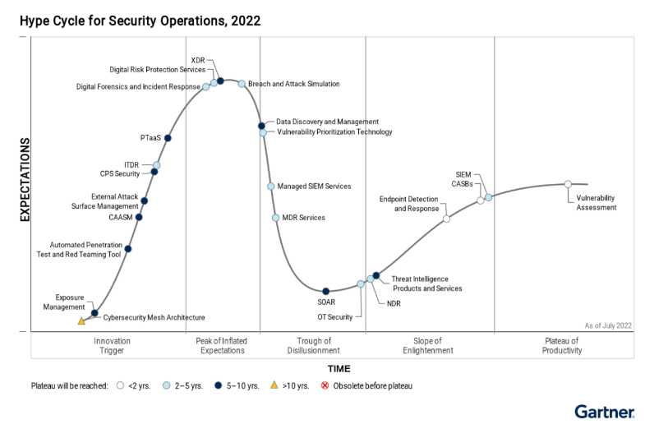
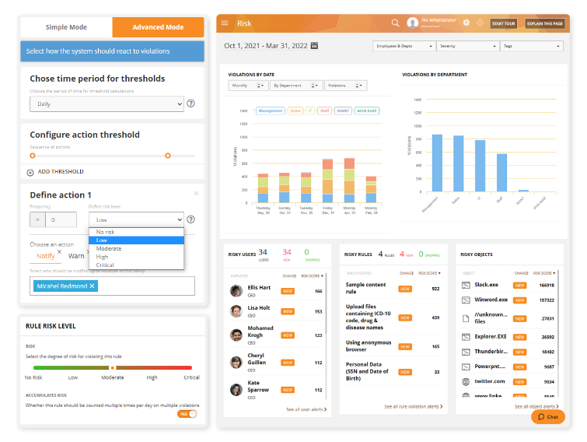

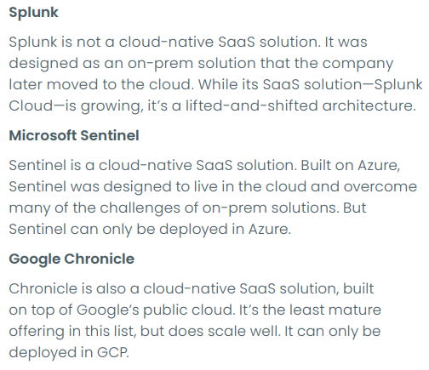
Technology Review Systems and Trends
Requirements
State of
the Art
System Design
ML Design
Approaches
SIEM (Security Information and Event Management): Collects security events. Analyze, investigate, correlate events often using logical rules. Create reports and dashboards
UEBA (User and Entity Behavior Analytics): Uses large datasets to model typical and atypical behaviors of humans and machines by means of machine learning algorithms
SOAR (Security Orchestration, Automation and Response): acts as the remediation and response engine to those alerts
Trends
Microsoft
Breach and Attack Simulation
Trends related to man-malicious operations
IBM
Splunk
SIEM → UEBA → SOAR
SIEM
SumoLogic
Security Orchestration, Automation and Response (SOAR)
Huawei
(Carrier) HiSec [2]
Elastic
AWS Security Services
GuardDuty (https://aws.amazon.com/guardduty/)
Macie (https://aws.amazon.com/macie/).
Network detection and response (NDR)
Systems
Limitations
SIEM History
SIEMs have been deployed in security operations centers (SOC) for 15 years
Originally designed as log collectors, SIEMs expanded capabilities to include detection methods (e.g., UEBA), compliance monitoring, …
SIEM/UEBA Challenges
Complex and expensive to deploy
Use simpler rule languages (c.f., SQL is too complex)
Generates large amounts of false positives
Statistical and ML-based filtering/noise reduction is needed
Requires technical expertise
Enable communities to create/manage their own rules
Use ML to automatically identify potential malicious attacks
Risky Users
Risky Rules
Risky Objects
[1] https://luminaanalytics.com/insider-threat/
[2] https://carrier.huawei.com/en/products/fixed-network/sub-solution-data-communication/HiSec

Slide 12
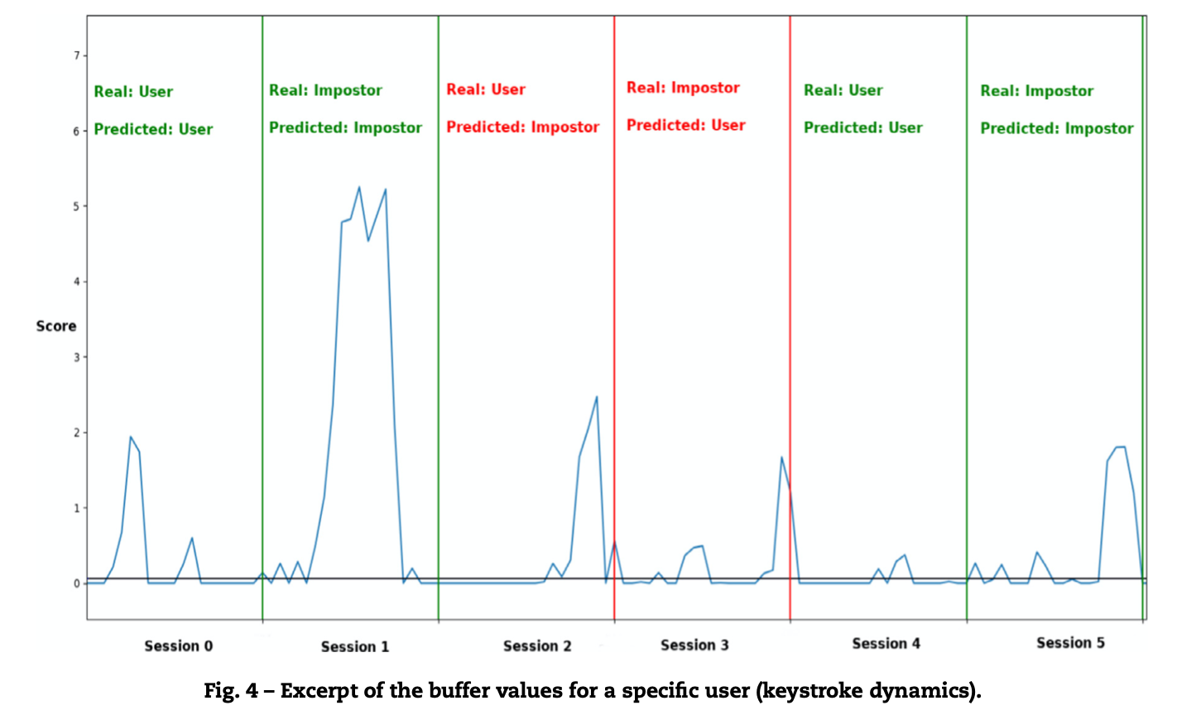
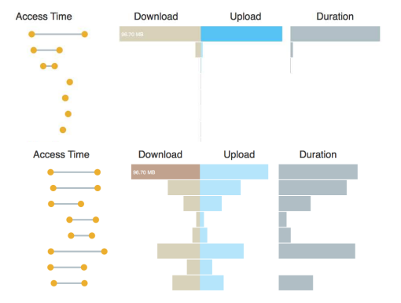
Technology Review User and Entity Behavior Analytics (UEBA)
Requirements
State of
the Art
System Design
ML Design
Definition: UEBA
Cybersecurity solution that uses algorithms and machine learning to detect anomalies in the behavior
Recognize unusual or suspicious behavior which diverges from normal everyday patterns or usage
For example, if a user regularly downloads files of 20 MB every day but starts downloading 4 GB of files, the UEBA system would consider this an anomaly and either alert an IT administrator
UEBA vs SIEM
UEBA use machine learning while SIEM uses rule-cased detection
UEBA creates models of normal behavior for individual users or components such as IP addresses, servers, applications by means of statistical analysis or learning methods in order to detect deviations.
The model is used to detect abnormalities
e.g. IBM QRadar UBA App, LogRhythm UEBA, ArcSight UBA, DarkTrace Enterprise
SIEM Limitations
First SIEM generation uses fix rules and regulations → too inflexible/costly
Static rules maintained by the provider that compare against dynamic lists of suspicious objects (e.g. IP addresses, URLs, hashes of binary code)
Rules and dynamic lists are renewed during updates, e.g. monthly
e.g. IBM QRadar SIEM, Tenable LCE and McAfee Enterprise Security SIEM
Anomaly
1
Baseline
1
2
[1]
Anomaly
2
Baseline
Fig. Examples of baselines and anomalous instances
[1] An approach to detect user behaviour anomalies within identity federations

Slide 13
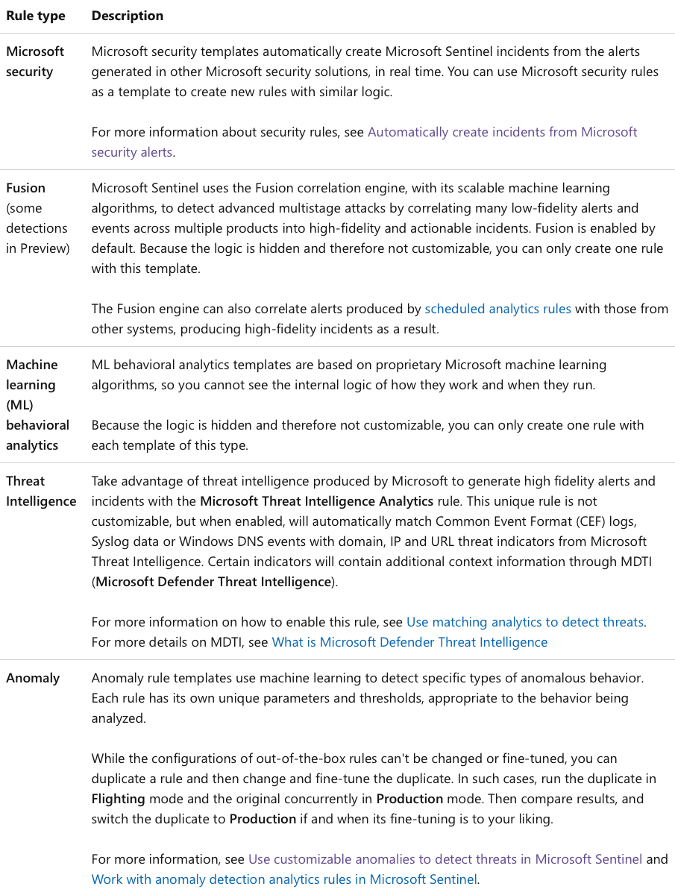
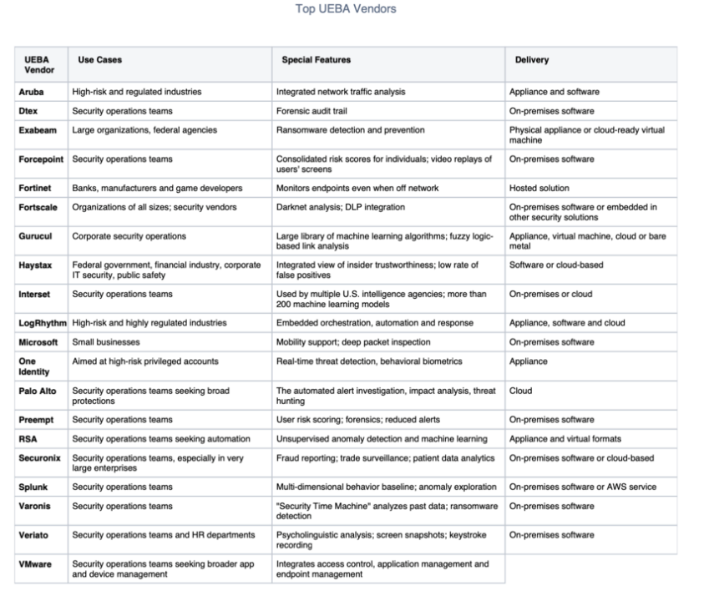
Technology Review UEBA: Microsoft & others
Requirements
State of
the Art
System Design
ML Design
Machine learning (ML) behavioral analytics ( )
Templates based on proprietary Microsoft machine learning algorithms
Not possible to see the internal logic of how they work
Top UEBA vendors main features ( )
Multi-dimensional behavior baseline
Predictive threat models
Predictive and adaptive learning
Behavioral groups
Daily consolidated risk scores for individuals risk prioritization
Risk scoring, risk-ranked timelines
Risky user behavior analysis
Alert scoring and prioritization
1
2
Top UEBA vendors
2
1
https://learn.microsoft.com/en-us/azure/sentinel/detect-threats-built-in
https://media.licdn.com/dms/image/C5612AQGIdRyltZM4ZQ/article-cover_image-shrink_720_1280/0/1651446475114?e=1686182400&v=beta&t=MKT1KPXUxWg4y3rDoQ6YtpoDBezzcKPcjxfNUxny7qM

Slide 14
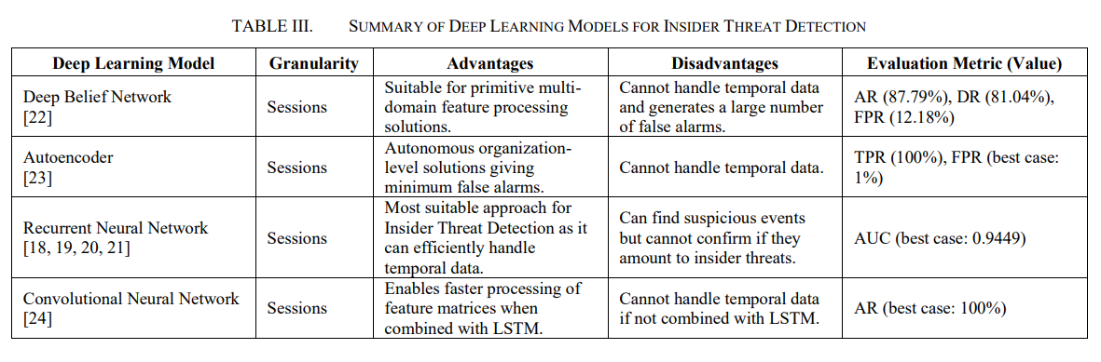
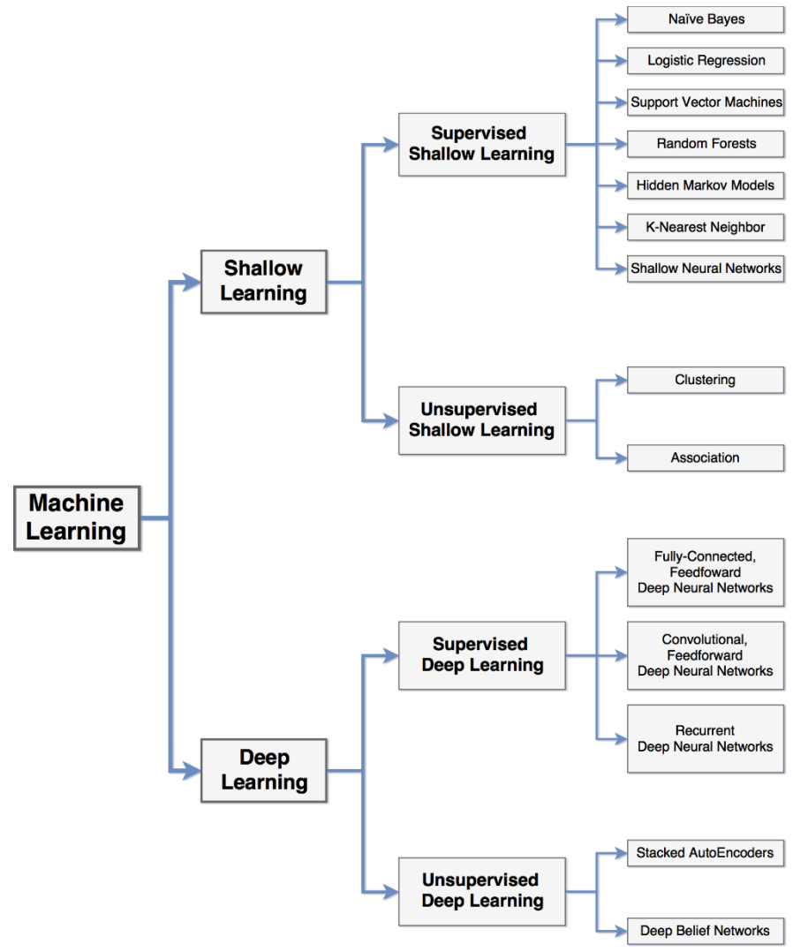
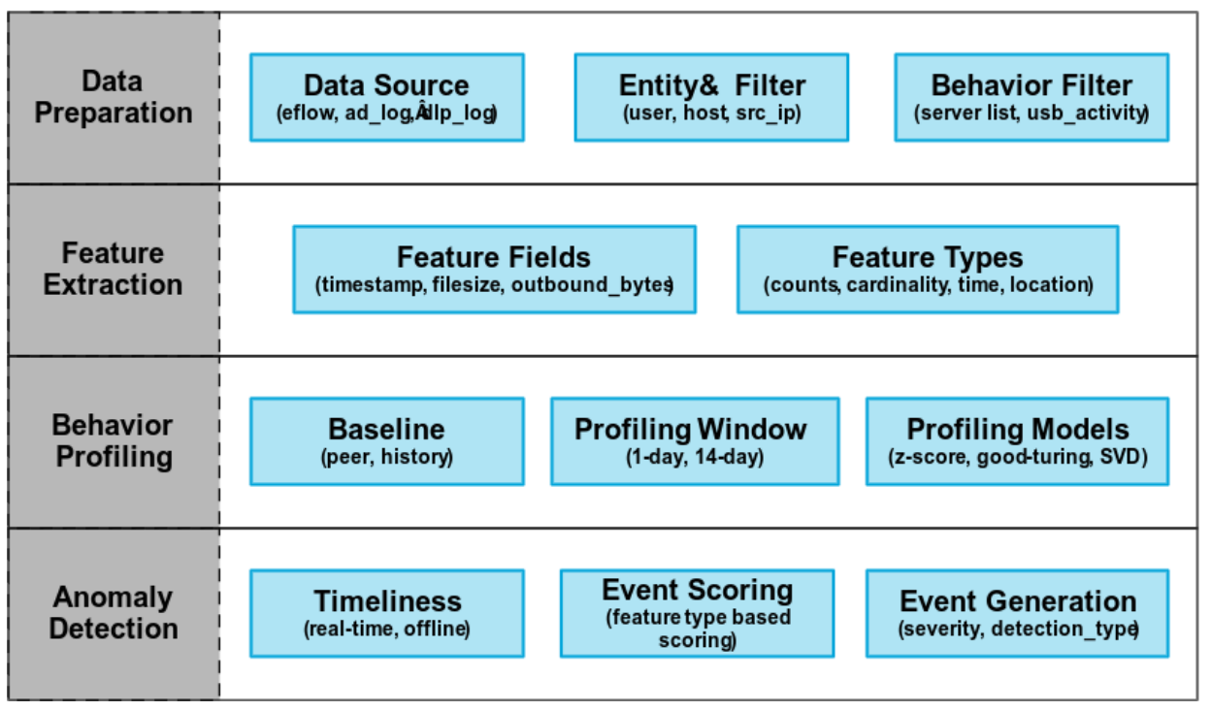
Technology Review UEBA: Algorithms and System Design
Requirements
State of
the Art
System Design
ML Design
Machine Learning Algorithms
Two classes of ML algorithms can be used: unsupervised and supervised
There is no “best” algorithm. It depends on the data and goal
[3] Insider Threat Detection using Deep Learning: A Review
Fig. Algorithms which can be used to build a baseline (i.e. model) compare instances against it [2]
known unknowns
unknown unknowns
Unsupervised Learning
K-means
Hierarchical Clustering
DBSCAN (Density-based Spatial Clustering of Application with Noise)
Local Outlier Factor
One Class SVM
System Design ( )
Data Preparation. Obtain data from all relevant data sources and apply filters, groupby, transformation, and integration
Feature Extraction. Generate new features based on custom made functions
Behavior Profiling. For each user/entity, the extracted features are used to generate model baselines using machine learning algorithms
Anomaly Detection. Instances (i.e., feature vectors) are scored against behavior profiles with an associated confidence score
1
Fig. General UEBA Architecture [1]
1
How it Works
ML algorithms are used to create baseline models to capture the normal behavior of users and entities, e.g.
Create a model for user A which logs into the same group of machines at approximately the same times every day
if user A suddenly logs into a different machine, the ML algorithm marks this new machine as an outlier since the behavior is far from the normal baseline
Challenge: how to identify how risky this abnormal behavior is?
An approach is to look at context: e.g., to analyze the behavior of peers
[1] User and Entity Behavior Analytics for Enterprise Security
[2] On the effectiveness of machine and deep learning for cyber security

Slide 15
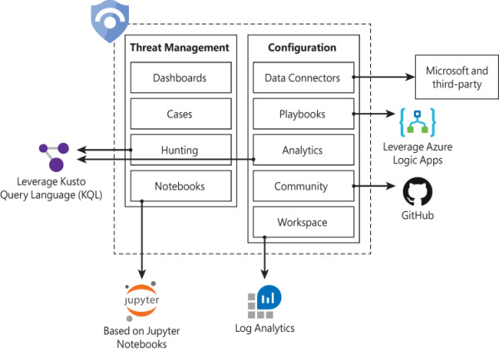
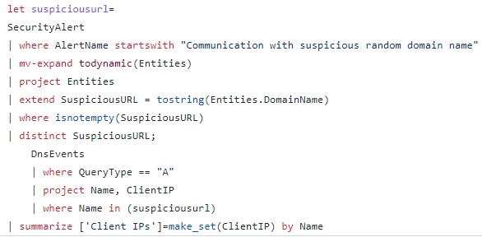


Technology Review Azure Sentinel
Requirements
State of
the Art
System Design
ML Design
Key features: Query language, connectors and rules build be the community, and support for investigations via jupyter notebook
Collect Data
Common Event Format (CEF), Syslog, REST-API, Fluentd, LogStash
Azure Active Directory, Azure DDoS Protection, Azure Firewall, Azure Web Firewall, Office 365, AWS CloudTrail, DNS, Azure Stack VMs, …
Community
GitHub that contains several data sources for threat: hunting queries, playbooks, workbooks..
Query Language
Kusto Query Language (KQL) enable to manipulate data in Sentinel: simple and efficient
1
1
2
3
4
2
3
4
Query for retrieving the failed logons (event id 4625) for the last 24 hours
SecurityEvent | where EventID == 4625 | where AccountType == 'User' | where TimeGenerated > now() - 24hrs | project TimeGenerated, Account, DomainController=Computer, IpAddress, LogonType, ClientHostName=WorkstationName, Activity, SubStatus
5
3
4
SQL to KQL mapping
https://learn.microsoft.com/en-us/azure/data-explorer/kusto/query/sqlcheatsheet
Query wrapper for (complex) query
https://github.com/Azure/Azure-Sentinel/blob/master/Solutions/Azure%20Active%20Directory/Analytic%20Rules/FailedLogonToAzurePortal.yaml
Investigation via notebooks
https://github.com/Azure/Azure-Sentinel-Notebooks
CI/CD
https://learn.microsoft.com/en-us/azure/sentinel/ci-cd?tabs=github
Query When a domain is flagged by Defender for Cloud (Azure Security Center) as suspicious then find any other clients that have queried that domain in DNS events
2
5
https://github.com/reprise99/Sentinel-Queries

Slide 16
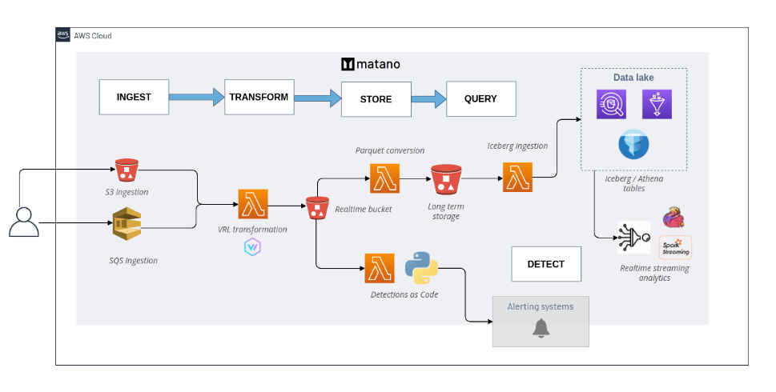
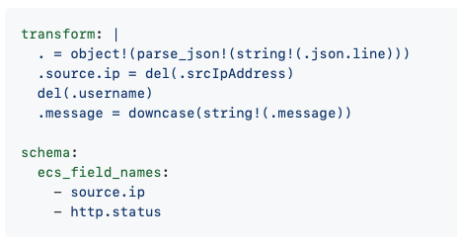
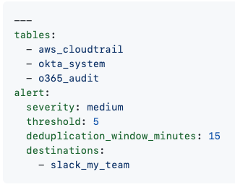
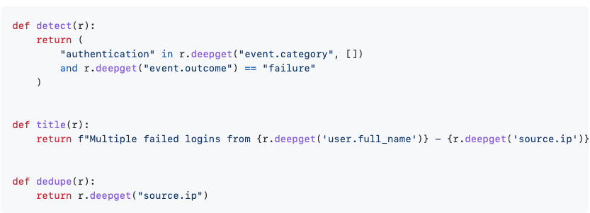
Technology Review Matano (open source)
Requirements
State of
the Art
System Design
ML Design
1
Data Ingestion
S3, SQS, AWS CloudTrail (governance, compliance, operational auditing, and risk auditing), Zeek (network security monitor), Okta (identity management service), and SaaS sources
ETL
Transformation pipeline via Vector Remap Language (VRL)
VRL was bought by DataDog. It replaces, e.g., Logstash
Uses Elastic Common Schema (from ELK/ES)
Dozens of transformations, pre-built parsers and integrations exist to ingest security logs from popular cloud, host, and SaaS tools using
Matano Architecture
1
2
3
4
2
Transform HTTP log events
Parse the raw line string into JSON, and explode the fields to the top level
Rename srcIpAddress to the source.ip ECS field
Remove the username field
Convert the message to lowercase
Detection-as-Code
3
Storage/Query Engines
Log stored in Parquet files in S3 object storage
Data lake with Big Data technologies: Apache Arrow (columnar memory format for flat/hierarchical data); Apache Iceberg (high-performance format for huge analytic tables; SQL; engines: Spark, Flink, Snowflake, Hive)
Detect Brute Force Logins by IP across all configured log sources (e.g. Okta, AWS, GWorkspace)
4
Detections as Code
Detection rules are coded in Python (detection-as-Code)
Rules are managed in Git (test, code review, audit for hardening)

Slide 17
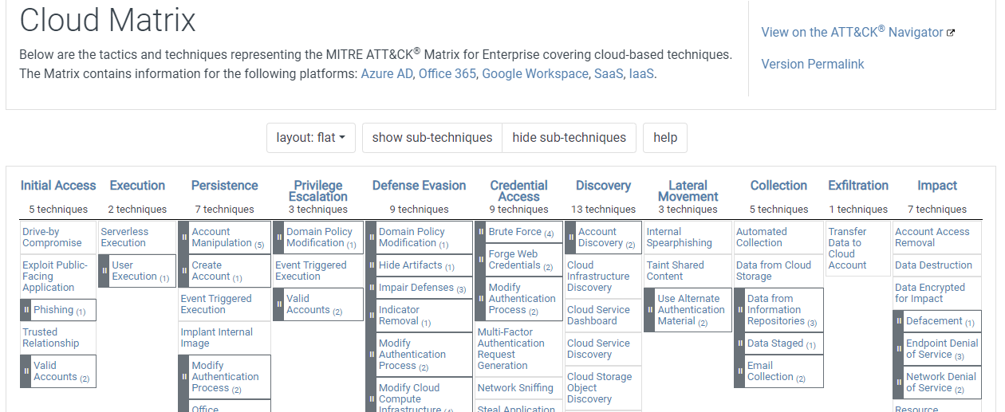
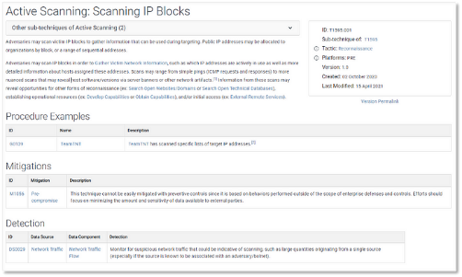
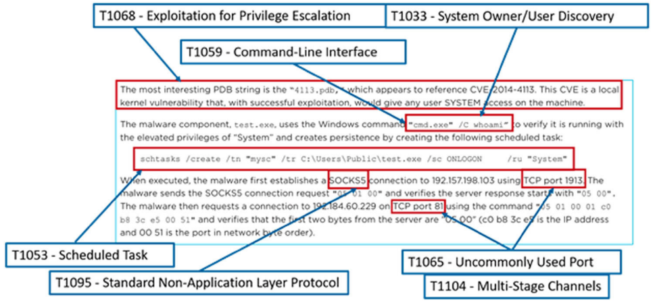
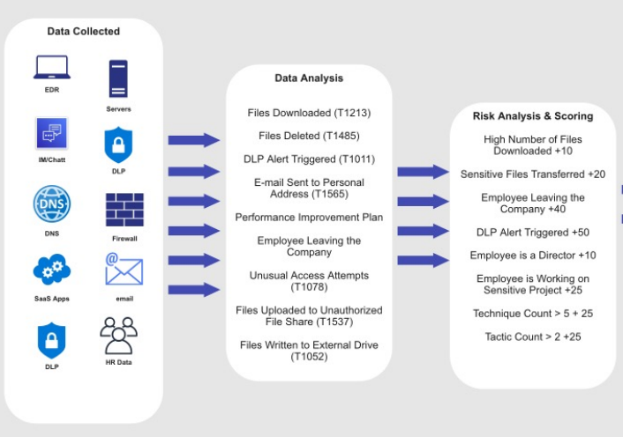
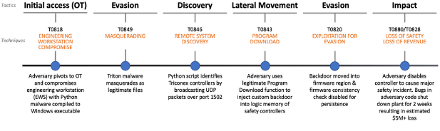
System Design Workflow Description [1]
Requirements
State of
the Art
System Design
ML Design
1
Identify Behavior
Brainstorming and understanding how a malicious attack works
Describe the scenarios to model
Map scenario to ATT&CK
Map tactics: e.g., TA0001: Initial Access
https://attack.mitre.org/tactics/enterprise/
Map Techniques: e.g., T1078: Valid Accounts
https://attack.mitre.org/tactics/TA0001/
Map Procedures: e.g., S0362: Linux Rabbit
Linux Rabbit acquires valid SSH accounts through brute force
Identify Data sources
Several technique lists relevant data sources that can help with the attack detection
E.g., process and process command line monitoring, often collected by Sysmon, file and registry monitoring, authentication logs, packet capture, …
Collect Data
Collect key data into some kind of search platform (DataLake, SIEM, DB, …)
E.g., Sysmon data → ELK
Update Knowledge Base of Analytics
Implement rules (pseudocode and native) and select machine learning models
See https://car.mitre.org/analytics/CAR-2016-03-002/
See https://github.com/redcanaryco/atomic-red-team/tree/master/atomics
See https://github.com/reprise99/Sentinel-Queries
The Enterprise Matrix is more complete and can also be used
2
Workflow can also start at step #2, and use the MITRE ATT&CK framework as a scenario generator
Tactics
https://car.mitre.org/analytics/CAR-2016-03-002/
Technique
https://attack.mitre.org/techniques/T1595/001/
https://medium.com/mitre-attack/getting-started-with-attack-cti-4eb205be4b2f
How to use Techniques and Rules to calculate an overall risk score
3
Files Deleted (T1485)
Using Kill-Chain and ATT&CK
4
Employee Leaving the Company
5
Unusual Access Attempts (T1078)
[1] https://medium.com/mitre-attack/getting-started-with-attack-detection-a8e49e4960d0

Slide 18
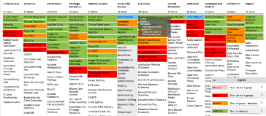

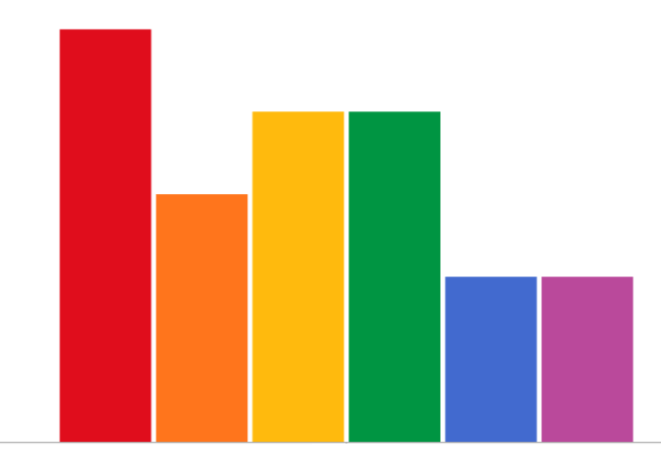
System Design Context
Requirements
State of
the Art
System Design
ML Design
Data Collection
JUMP
SERVER
SOP
SERVER i
HR
Network
Commands
Change Orders
Audit logs
Employment
Config
Transport
Change order + Session (set of commands executed by an operator)
Insider Threat Detection
ATT&CK Framework
Behavior Analysis (AI/ML Models/Tasks)
Check Behavior B1
Check Behavior B2
Check Behavior B3
Check Behavior B4
Check Behavior B5
If behavior is different, raise alarm
Behavior Model
Threat Detection
Behavior Rules
History Today
Rule #7 [Employee Leaving]:
if employee is leaving the company in 2 weeks
if he has done logins at 8pm – 8 am
if has executed commands P3-P5
if he did not use a Change Order
then raise alarm [Employee is Risky]
Generate anomaly alarm
Generate rule –based alarm
(*) https://ctid.mitre-engenuity.org/our-work/insider-threat-ttp-knowledge-base/
https://github.com/center-for-threat-informed-defense/insider-threat-ttp-kb

Slide 19
System Design High Level View
Requirements
State of
the Art
System Design
ML Design
1
Input Data
Data comes from different logging systems such as OREO, Bastion, SOP, Audit, HR, Network
1
Data Collection
Data Sources: Jump Server, SOP, Audit, HR, Network, …
HR data
(resignation)
Access
(VPN, login)
Location
(work, remote)
Reason
(SOP, None)
Activities
(CLI commands)
Time
(Weekend, after work)
2
Data Pre-processing/Transformation
Apply transformations to incoming data
Filter out irrelevant data and remove sensitive information
Enrich existing data with analytics or external data
2
Data Preprocessing/Transformation
3
Rule Engine
SecOps: Detection as Code (DaC)
DaC is a modern approach to building threat detection
The simplicity of rule definitions is key for adoption and management
Don’t make the query any more complex than absolutely needed
Contrast: Google YARA-L vs. Azure KQL
Sigma simplicity is an option to consider
https://github.com/SigmaHQ/sigma
Rule development follows CI/CD workflows
Structured process that lets teams participate in building and improving rules for SIEM
Role and User
5W+H
Time-based
Aggregator
(day, week)
Drill
(up, down)
Operators
(count, freq)
who, how, where, why, what, when
Operation vector:
Behavior Analysis
4
Feature Extraction / Engineering
Aggregation by day, week, month, …
Normalization
5W + H
4
Feature Engineering
Aggregated data is processed to construct feature vectors representing user activities and profile information at different granularity levels
Frequency features. Count of different types of actions the user performed in the aggregation period, e.g., number of commands executed, number of logins after work hour, …
Statistical features. Descriptive statistics, such as mean, median, standard deviation, of data. Examples of data that are summarized in statistical features are file sizes and session duration
Behavior profile:
3
Rule Engine
5
Unsupervised Machine Learning
Rules-as-code
Detection as Code (DaC)
DSL
Behavior Rule #7 [Employee Leaving]:
if employee is leaving company in 2 weeks
if he has done logins at 8pm – 8 am
if has executed commands P3-P5
then raise alarm [Employee is Risky]
[■□□■□□]
HBOS
Isolation Forrest
5
Unsupervised Learning
ML algorithms are employed to data analytics based on the constructed feature vectors.
Supervised learning algorithms cannot be employed to learn the ground truth on malicious/normal user behaviors
System operates without the participation/supervision of security analysts
Automatically learn patterns characterizing normal activities and behaviors
[.9, .2, .1, .9, .7, .3 ]
anomaly score: .78
Deterministic
Probabilistic
L1 Alert: Rule violation
L2 Alert: Possible behavior violation
(*) https://ctid.mitre-engenuity.org/our-work/insider-threat-ttp-knowledge-base/
https://github.com/center-for-threat-informed-defense/insider-threat-ttp-kb

Slide 20
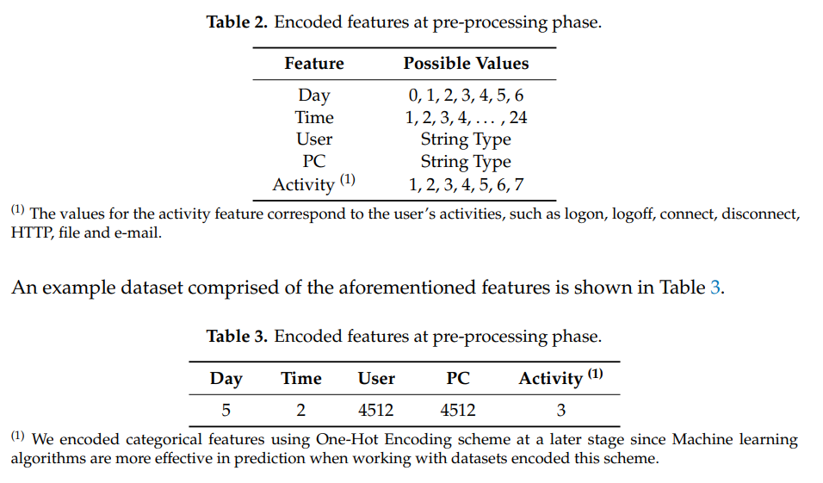
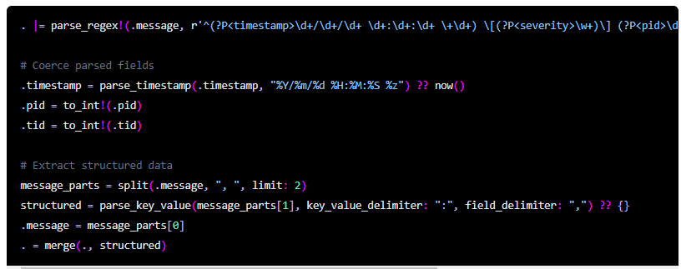
Data Collection/Preprocessing Concepts and Technologies
Requirements
State of
the Art
System Design
ML Design
Data Sources
System records each user operation/action. The information comes from different sensors within the organization.
Information is classified using the 5W1H method
In our initial work, we used the data sets provided by CMU-CERT which provide activity logs with different activities: login, usb device, e-mail, web, file access.
For Huawei Cloud, the complete set of sensors still need to be identified.
5W1H Method
We use 5W1H as a questioning and problem-solving method to analyze users’ operations from different perspectives.
It helps to understand the context of users’ operations and find the root cause of abnormal/malicious actions.
5W → What, Where, When, Why, Who; H → How
Who executed the operation?
What was executed?
When was it executed?
Where was the operation executed?
Why was the operation executed?
How was it executed?
Data Sources: OREO, Bastion, SOP, Audit, HR, Network, …
WHO HOW WHERE WHY WHAT WHEN
Role | User | Termination | Protocol | Session | Status | Office | Remote | … | SOP | Change Ticket | … | Command | OREO Label | … | Date / Time | Weekend | After hours
SRE | J00123 | TRUE | bastion | SE123 | SUCCESS | TRUE | FALSE |  | S92 | CT03 |  | ls –al | P5 |  | 03.04.23 | TRUE | TRUE
Semantic classification of data sources
Data Preprocessing
Machine Learning algorithms understand only numbers, thus, conversion is needed
Technologies
Technologies: Vector, Vector Remap Language (VRL), Filebeat, FluentBit, FluentD, Logstash
Examples of VRL language for .json transformation
Examples of data sensors for Who
Security | Frequent or unusual security incidents, compliance violations
Performance | Declining or poor performance, HR complains or demotion
Personality | Past lies to the employer, psychological disorders
[1] Metadata and examples from CERT r5.2 (CERT Datasets: https://doi.org/10.1184/R1/12841247.v1.) which simulates an organization with 2000 employees over the period of 18 months. Dataset consists of user activity logs, categorized as follows: login/logoff, email, Web, file and thumb drive connect, as well as organizational structure and user information

Slide 21
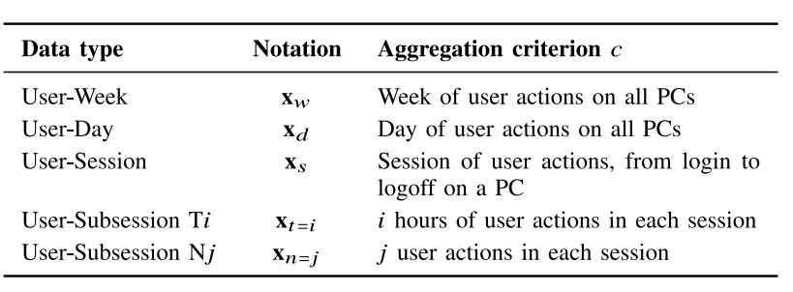
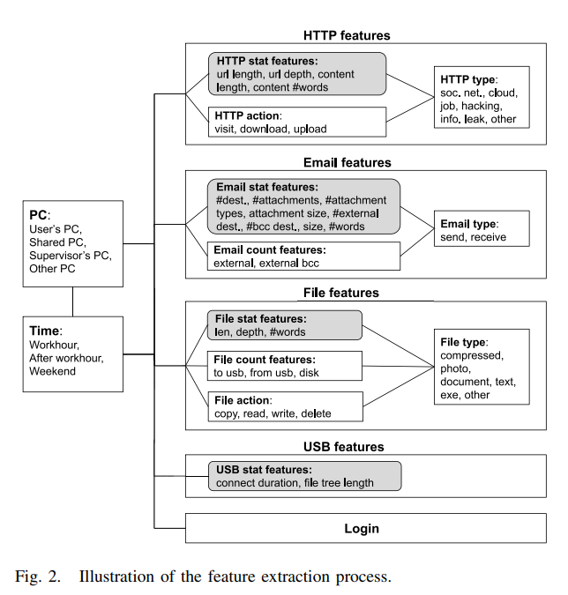
Behavior Analysis Machine Feature Extraction / Engineering
Requirements
State of
the Art
System Design
ML Design
Behavior Profile
For each user and role (who), and for each 4W+H model of the vector, we build a behavior profile that denotes the operations for a particular user based on the observed records
E.g., in [1], user-week, user-day, and user-session profiles were adopted
Feature Extraction
For each behavior profile, perform feature extraction
This enables the ML algorithm to compare between users, roles, and derived characteristics of the 5W+H model which are relevant
Features enable an assessment of 3 key areas:
User’s hourly/daily/week/weekend operations
Comparison (user’s operations vs previous operations)
Comparison (user’s operations vs other users with same role)
Features
Several types of features need to be evaluated, e.g.:
New observations across where, when, what, how, who
e.g., new remote login on holiday
New computer access for user/role
New command execution for user/role
Count. Assess the hourly and daily usage counts for where, when, what, how, who
e.g., number of logins during the night
Daily number of commands executed
Time. Time-based features for each particular activities (e.g., earliest login)
The final feature matrix will contain tens extracted features
4
Feature Extraction / Engineering
Aggregation by day, week, month, …
Normalization
5W + H
Behavior profile:
Graphical representation of the profiles created. (1) For each 4W+H profiles, we compute deviation values using, e.g., standards deviation or covariance. (2) The deviation value is used to identify anomalous behavior.
Examples of features extracted for the CERT R5.1 dataset
https://resources.sei.cmu.edu/library/asset-view.cfm?assetid=508099
[1] Analyzing Data Granularity Levels for Insider Threat Detection Using Machine Learning

Slide 22


Behavior Analysis Unsupervised Machine Learning
Requirements
State of
the Art
System Design
ML Design
Single Abnormal Behavior Detection
Each behavior profile is compared using, e.g., HBOS [1]
For each selected feature, we prepare a set of training histograms.
We then map the vectors of training histograms into a metric space so that: 1) two similar histograms are close in space, whereas 2) two dissimilar histograms are far away.
A number of different approaches can be used to quantify how similar two histograms are.
Full Abnormal Behavior Detection
Isolation Forests (IF) can be used for anomaly detection since they are efficient for large datasets
The results of single abnormal behavior detection are placed in a vector
E.g., [.9, .2, .1, .9, .7, .3 ]
All samples are used to build a model, IF will classify vectors which can be quickly isolated within the tree constructed
5
Unsupervised Machine Learning
[■□□■□□]
HBOS
Isolation Forrest
[.9, .2, .1, .9, .7, .3 ]
anomaly score: .78
Several techniques for histogram-based outlier detection need to be evaluated.
Statistical techniques
Density-based
Clustering-based
HBOS is used to detect profiles which are outliers. In some cases, all individual profiles are normal, but their combination is abnormal. Thus, we use Isolation Forests as a second level of insider threat detection.
Example of the use of Isolation Forests to isolate vectors which are outliers
[1] Goldstein, M. Histogram-based outlier score (HBOS): A fast unsupervised anomaly detection algorithm. 2012

